Slide 1
Navigating pandemic supply challenges
Team ID: 2230672

Slide 2
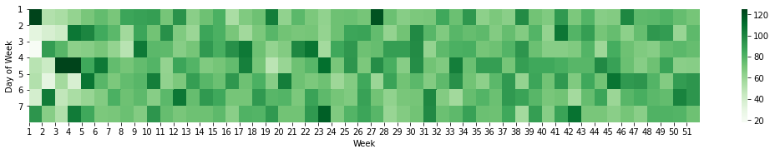
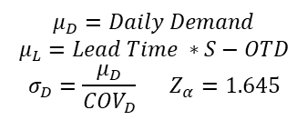
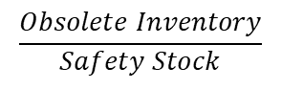
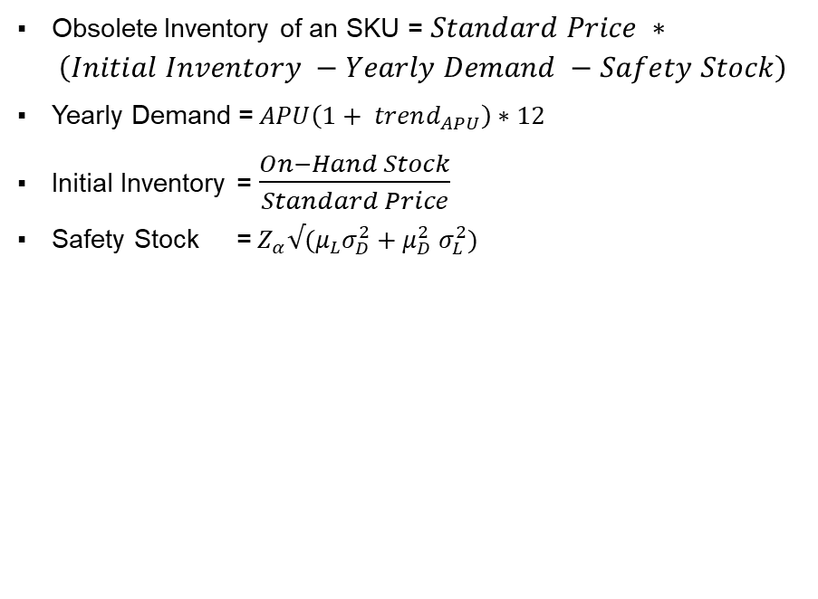
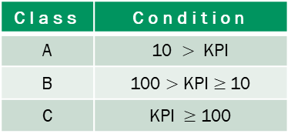
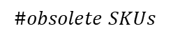
Obsolete Inventory
Formulae used for derivation :
Unaccounted parameters for Cost Reduction
Obsolete Inventory of an SKU = $Standard Price ∗ \left(Initial Inventory −Yearly Demand −Safety Stock\right)$
Yearly Demand =$APU\left(1+ trend_{APU}\right)∗12$
Initial Inventory =$\frac{On−Hand Stock}{Standard Price}$
Safety Stock =${ Z}_{α}√(μ_{L}σ_{D}^{2}+μ_{D}^{2} σ_{L}^{2})$
On average 77 SKUs are placed on order for replenishment daily
Heatmap of #orders
$$μ_{D}=Daily Demand$$
$$μ_{L}=Lead Time ∗S−OTD$$
$$σ_{D}=\frac{μ_{D}}{{COV}_{D}} Z_{α}=1.645$$
Both Demand and Delivery Lead Time are
assumed to be normally distributed
Order Aggregation in terms of
Coordinated Transportation for delivering multiple SKUs
For SKUs sourced from single supplier :
Constraint for Lot Sizes to maintain Full Truck Load
Managing Joint Economic Lot Sizes for profitability
For aggregating order arrivals from multiple suppliers :
Information systems to organize dispatches based on lead times
Economic Order Quantity due to absence of data on
Holding Cost
Supplier Discounting Schedule
Defined KPI
$$\frac{Obsolete Inventory}{Safety Stock}$$
115.45 %
$$\#obsolete SKUs$$
31
Class | Condition
A | 10 $>$ KPI
B | 100 $>$ KPI $≥$10
C | KPI $≥$ 100
Ordering Fixed Cost
Potential 31 obsolete SKUs result to a Total Obsolete Inventory of $ 46,263.575

Slide 3
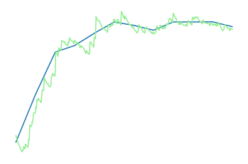
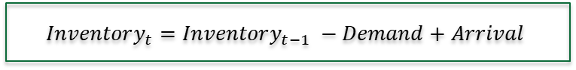
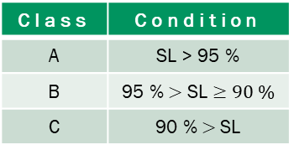

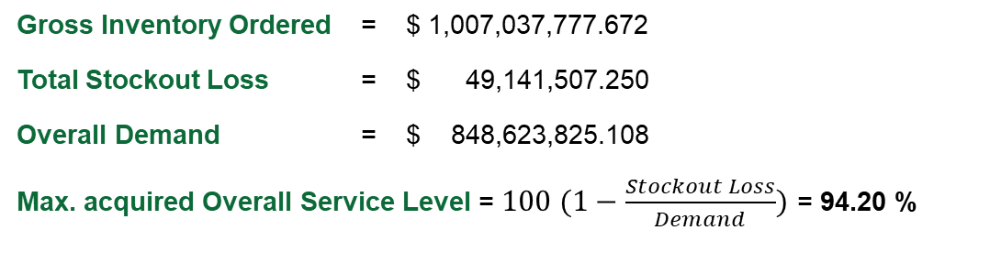
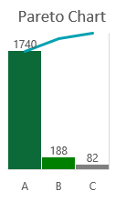

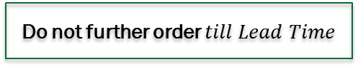
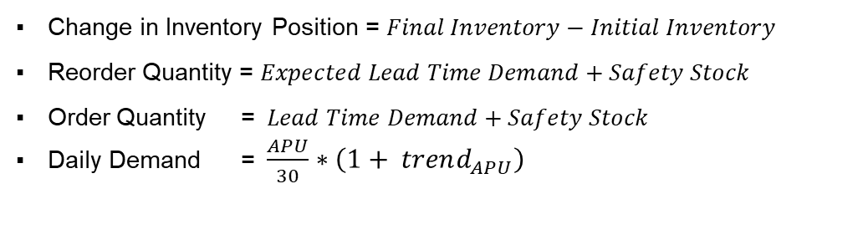
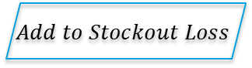
Working Capital Impact
Observed SCM Metrics
Inventory Management Schema for SKUs
Gross Inventory Ordered = $ 1,007,037,777.672
Total Stockout Loss = $ 49,141,507.250
Overall Demand = $ 848,623,825.108
Max. acquired Overall Service Level = $100 (1−\frac{Stockout Loss}{Demand})$ = 94.20 %
$$Inventory_{t}=Inventory_{t−1} −Demand+Arrival$$
If negative
$$Add to Stockout Loss$$
$$\text{IF} Inventory_{t}≤Reorder Quantity$$
$46,008,199.786
$160,959,590.055
97.844 %
$$Arrival after Lead Time=Order Quantity$$
Initial Inventory
Final Inventory
Average Service Level
For all 360 days
Do not further order $till Lead Time$
100%
ABC Classification
180M
Formulae used for calculation :
Class | Condition
A | SL > 95 %
B | 95 % $>$ SL $≥90 \%$
C | 90 % $>$SL
Change in Inventory Position = $Final Inventory−Initial Inventory$
Reorder Quantity = $Expected Lead Time Demand+Safety Stock$
Order Quantity = $Lead Time Demand+Safety Stock$
Daily Demand = $\frac{APU}{30}∗\left(1+ trend_{APU}\right)$
Daily Inventory Level
28M
* SL – Service Level
0
360
Value of Assets under Inventory shall increase by $ 114,951,390.27

